Slide 1

NIYUKTI
To bridge the gap between student preparation and placement opportunities through AI-powered, data-driven placement management.
Team Atom
Aayush Rathore
Abhyansh Sahu
Ansh Vardhan Dixit
Nitin
Priyanshu Shrivastava
Rajnish Kumar
Praphull Parnav
Manshu Devi
Shiwani Jha
Shri Sharma
Shruti Pandey
Vani Singh

Slide 2
Problem statement
Proposed Solution
T&P teams spend significant time managing student data, checking company-wise eligibility, processing applications, conducting assessments, shortlisting candidates and maintaining placement records.
Students use separate platforms for resumes, coding, aptitude, technical preparation and interviews, making their preparation and placement journey fragmented.
Assessment, interview and student-performance data remains scattered, making it difficult to get a complete view of a student's placement readiness.
Manual shortlisting and analysis become difficult when the number of students and placement drives increases.
T&P teams have limited real-time insights into student skill gaps, performance and placement progress.
Niyukti is an AI-powered placement management platform that connects student preparation with the complete T&P placement process.
Centralized Student Profile — academics, skills, resume, projects, assessments and placement history.
T&P Placement Management — companies, placement drives, eligibility, applications, assessments, interviews and selection.
AI-Based JD Analysis & Matching — analyzes company requirements and matches them with student profiles and skills.
AI-Assisted Shortlisting — helps T&P identify relevant candidates based on eligibility and performance.
Assessment & Performance Analysis — aptitude, technical and coding assessments with centralized results.
Skill Gap & Personalized Preparation — identifies areas for improvement and recommends relevant preparation.
AI Mock Interviews — technical and HR interview practice with structured feedback.
T&P Analytics — placement funnel, student performance, skill gaps, drive-wise insights and reports.

Slide 3
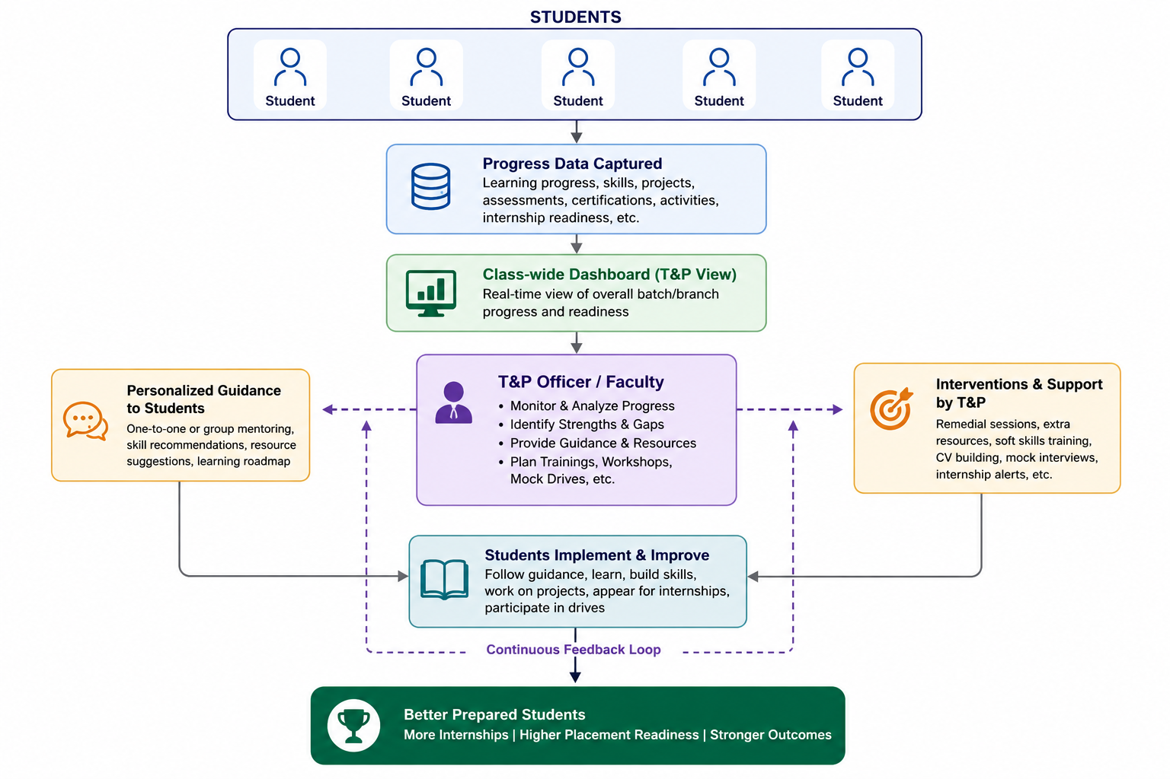
What Niyukti Offers the T&P Department
Student Progress Monitoring – Track students' skills, projects, certifications, learning progress, and internship readiness through a centralized dashboard.
Company & Drive Management – Manage companies, internship opportunities, placement drives, eligibility criteria, roles, packages, and deadlines.
AI-Assisted Shortlisting – Automatically identify and shortlist eligible candidates based on skills, progress, certifications, and company requirements.
Interview & Assessment Management – Schedule assessments, mock interviews, technical rounds, mentoring sessions, and monitor participation.
Analytics & Insights – Generate batch-wise and branch-wise reports, readiness analytics, placement statistics, and historical trends.
Placement Workflow: Company Added → Drive Created → Eligibility Defined → Applications Open → AI Shortlisting → Assessment → Technical Interview → HR Interview → Selection & Analytics

Slide 4
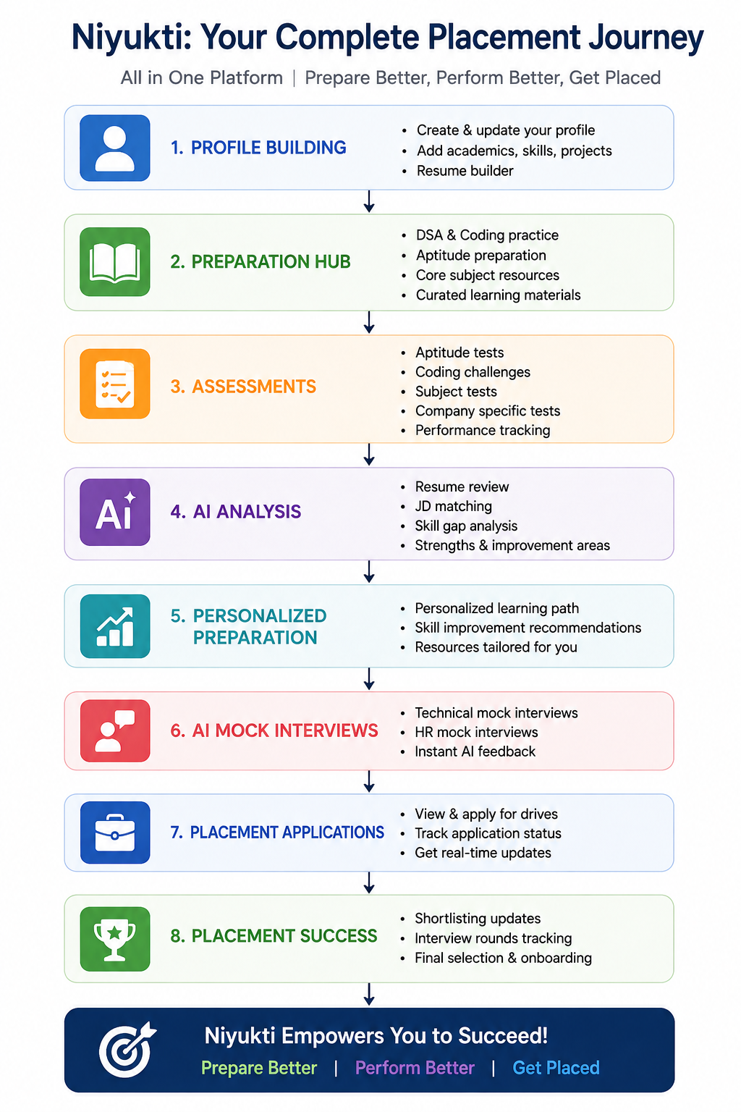
What Niyukti Offers to Students
Centralized Student Profile — Manage academic details, skills, projects, certifications, and resume in one place.
Personalized Placement Preparation — Access aptitude, coding, DSA, technical, and core-subject preparation.
Company-Specific Preparation — Prepare based on company requirements, roles, and placement patterns.
Assessments & Performance Tracking — Take assessments and monitor performance, progress, strengths, and areas for improvement.
AI Resume Analysis — Analyze resumes and identify areas for improvement.
Resume–Job Matching — Match student skills and profiles with relevant job roles and company requirements.
AI-Based Skill Gap Analysis — Identify missing skills and receive recommendations for improvement.
AI Mock Interviews — Practice technical and HR interviews with structured AI-generated feedback.
Placement Drive Access — View eligible companies, placement opportunities, and application details.
Application & Progress Tracking — Track applications, assessment status, interview stages, and placement progress.
Personalized Recommendations — Receive preparation suggestions based on performance, skills, and target roles.

Slide 5
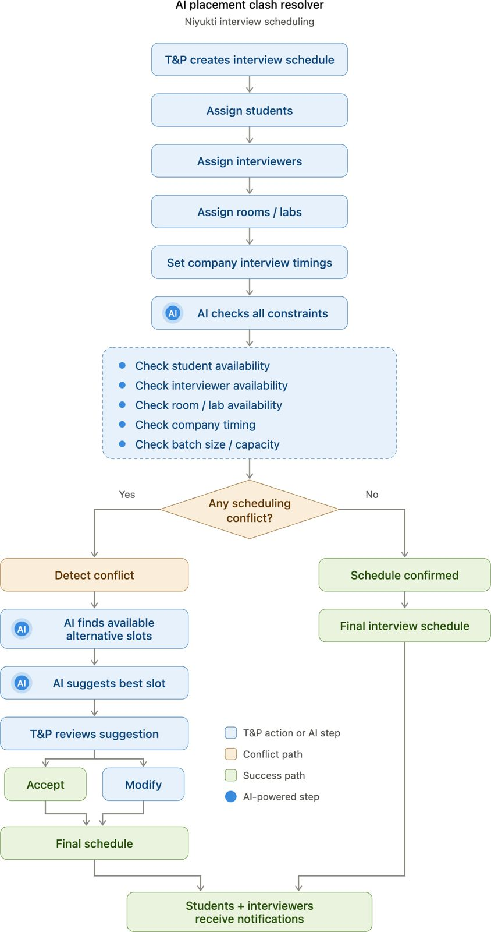
AI Solutions for the Placement Cell
01 | JD INTELLIGENCE
AI analyses company JDs to identify eligibility, required skills, qualifications and role-specific requirements.
02 | SMART MATCHING & SHORTLISTING
Matches students with suitable roles using academic, skill, resume and assessment data — supporting the Placement Cell in shortlisting.
03 | STUDENT READINESS
Analyses performance & skill gaps to recommend personalized preparation, resume improvements and AI-powered mock interviews.
04 | PLACEMENT CELL INTELLIGENCE
Converts placement data into insights on applications, assessments, selections, student readiness and drive-wise performance.
AI-DRIVEN PLACEMENT FLOW
Company JD → AI Analysis → Student–Job Matching → Student Preparation → Performance & Skill-Gap Analysis → T&P Shortlisting → Interview → Placement Insights

Slide 6
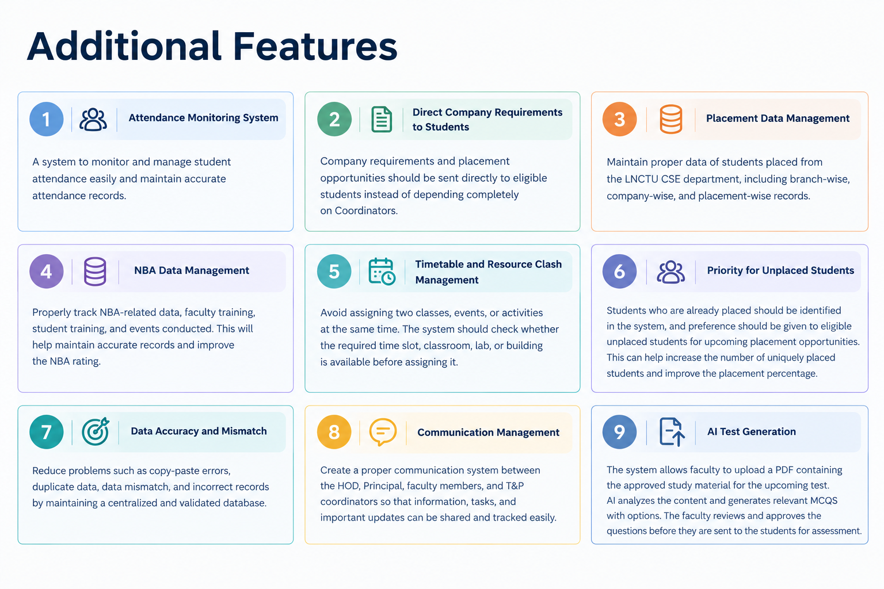

Slide 7
Challenges Faced
Tech Stack
Personalized Roadmap Generation – Every student has different goals and skill levels, making it challenging to create relevant and customized learning paths.
Accurate AI Recommendations – Ensuring that AI suggestions are meaningful and aligned with student profiles, skills, and career aspirations.
Student Progress Tracking – Consolidating data from courses, projects, certifications, and assessments into a unified progress system.
AI-Based Shortlisting – Automatically matching students with company eligibility criteria while maintaining accuracy and fairness.
Scalability for T&P Departments – Managing and analyzing data for large numbers of students across multiple batches and branches.
Keeping Data Updated – Regularly updating learning resources, internship opportunities, and company requirements.
Student Engagement – Encouraging students to consistently update their profiles and actively use the platform.
Mobile App: Kotlin • Jetpack Compose • MVVM • Retrofit • Coroutines/Flow • Hilt
Web Portal: React • TypeScript • Vite • Tailwind CSS • Recharts • Monaco Editor
Backend: Node.js • Express.js • TypeScript • REST APIs
Database & Storage: MongoDB • Mongoose • Atlas Vector Search • S3/MinIO
AI & Intelligence: OpenAI/Gemini • Resume Analysis • JD Matching • AI Recommendations
Security: JWT • Passport.js • RBAC • Zod
Assessments & Real-Time: Judge0 • Docker • Socket.IO • Redis • BullMQ
Communication & Reports: Nodemailer • Firebase Cloud Messaging • ExcelJS • Puppeteer
Testing & DevOps: Jest • Playwright • Docker • GitHub Actions • Sentry

